Slide 1
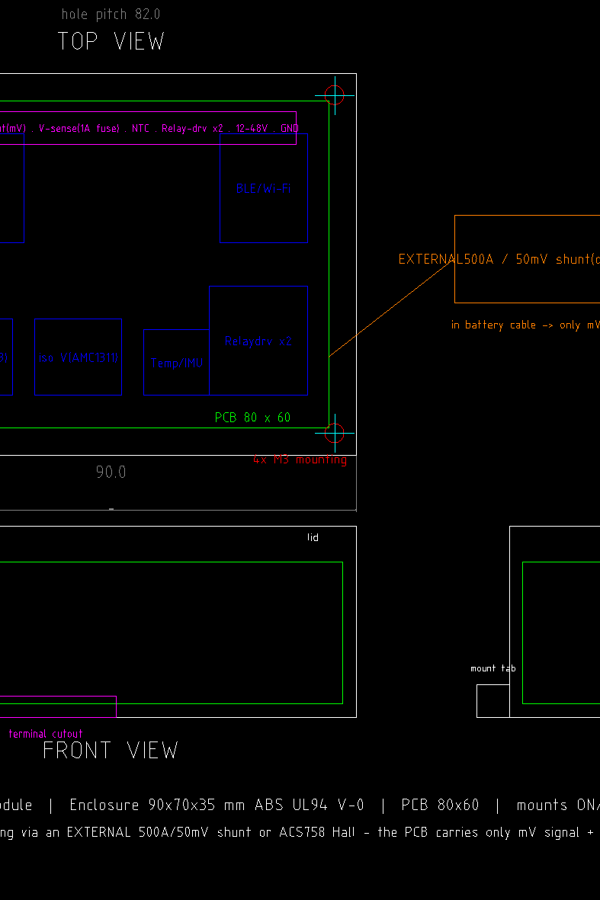

V-Guard Sentinel: the self-aware home inverter
Team: Codey Tingle (TI3271) · Ayush Manoj Garg, Eshan Shukla, Tanay Chaplot
Problem: India's home inverters switch in under 10 ms but are blind to the one part that actually fails — the battery. It dies without warning, the family loses backup and pays ₹15–18 k, and V-Guard pays inside the warranty window. Today's products sense voltage and current and turn none of it into foresight.
V-Guard Sentinel · Team Codey Tingle (TI3271) · Big Idea Tech 2026, Track 4

Slide 2
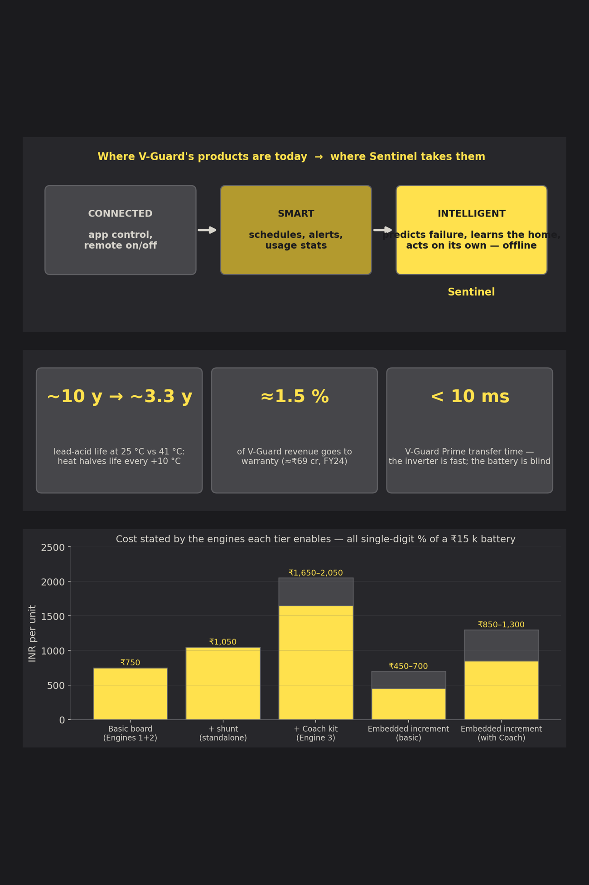
Our Vision & Mission
Vision
Every V-Guard product moves from smart to intelligent: it predicts its own failure, learns its owner's habits and acts on its own — offline, on a ₹300 microcontroller.
Goals
Tech Stack
• Never let a battery die unannounced
• Keep the essentials alive through every blackout
• Turn warranty into evidence, not argument
ESP32-S3 · TensorFlow Lite Micro (int8) · Kalman filtering · event-based NILM · IEEE 1159 power quality · ECDSA-signed logs · Flask dashboard · ESP-IDF firmware · Python/C prototype with 245 tests
V-Guard Sentinel · Team Codey Tingle (TI3271) · Big Idea Tech 2026, Track 4

Slide 3
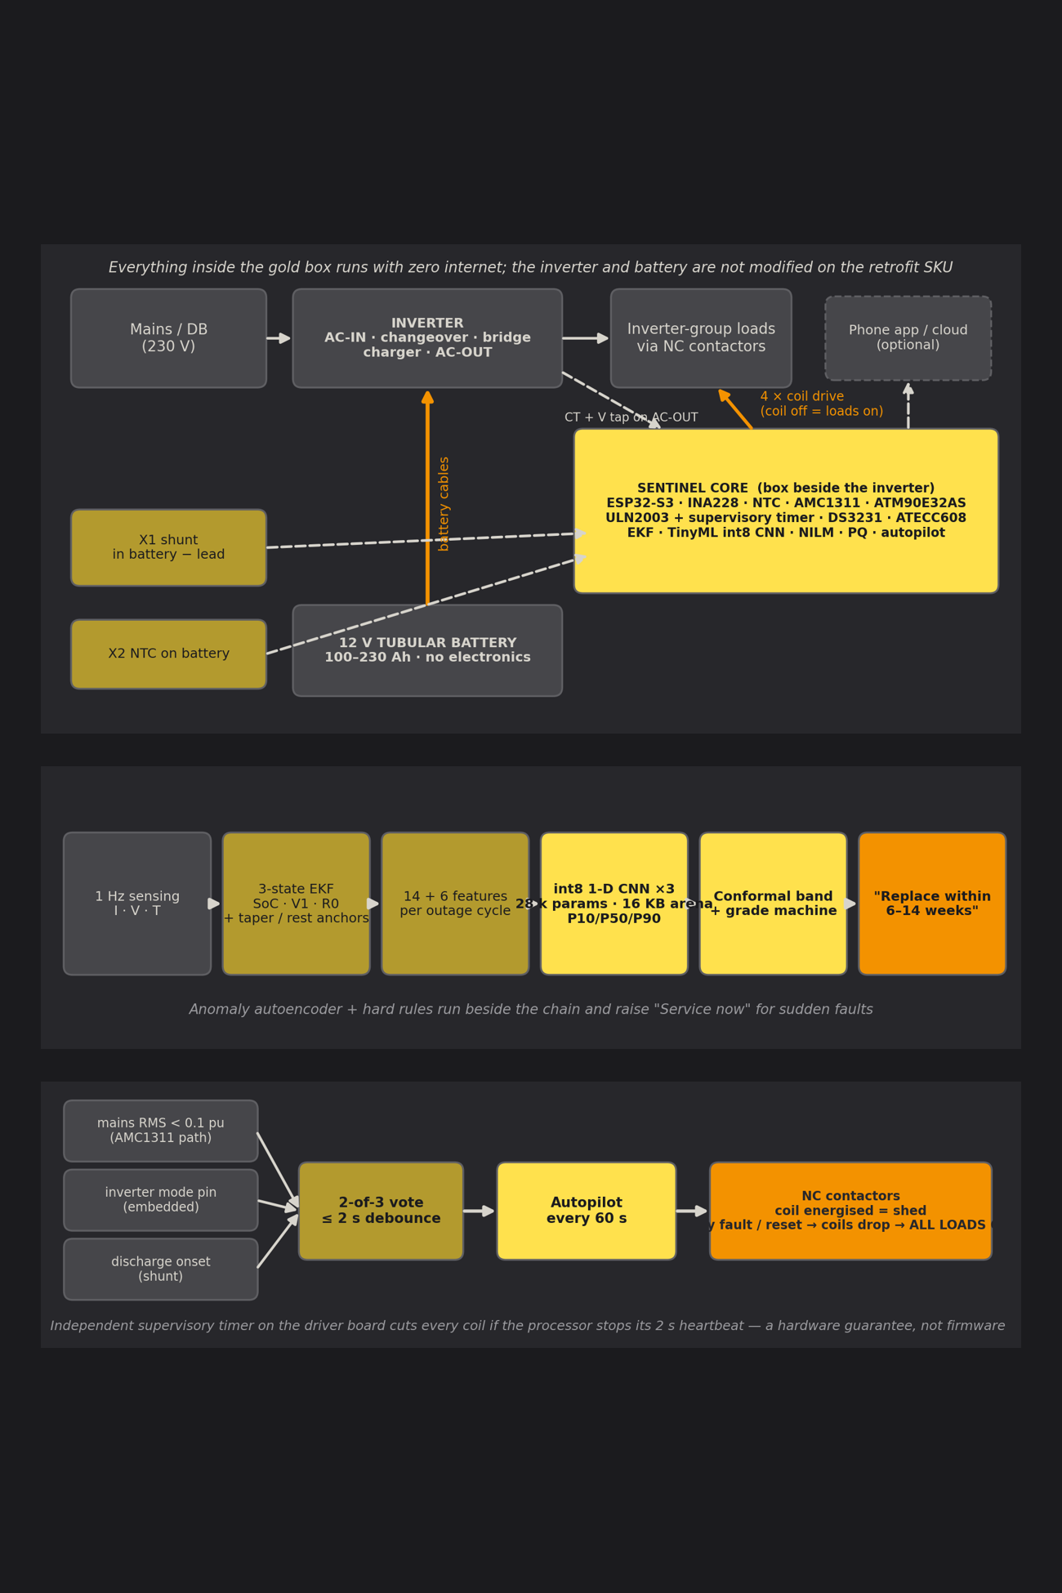
Sentinel Engine Suite
1
Engine 1 · Battery Health
Coulomb counting and a Kalman filter fuse current, voltage and temperature into state of charge; a 28 k-parameter int8 network turns each outage cycle into a state-of-health band and the warning “replace within 6–14 weeks”.
2
Engine 2 · Habit Autopilot
Learns the home's load and outage rhythm, detects a blackout in under 2 s by a 2-of-3 vote, and sheds heavy loads by tier so the fridge, lights and router last longest. Every fault fails safe: coil off means loads on.
3
Engine 3 · Energy Coach & Grid Shield
A metering front-end on the inverter output gives real and reactive power. Appliance events are recognised and priced; sags, swells and interruptions are logged as appliance-protection evidence.
4
Engine 4 · Fleet Intelligence
Consented, pseudonymised per-cycle summaries (~1 KB/day) train better models centrally and return over the air. Federated learning is designed and deliberately on hold.
Key advantage: every core function runs with zero internet — a virtue in India, not a compromise; retrofits the installed base or embeds in new inverters.
V-Guard Sentinel · Team Codey Tingle (TI3271) · Big Idea Tech 2026, Track 4

Slide 4
The Product Kits
Sentinel-Retrofit box
Sentinel-Embedded board
Core board beside the inverter · external 0.1 mΩ shunt in the battery negative lead · NTC on the battery · CT + voltage tap on AC-OUT · 4 fail-safe contactor channels.
Daughter-board inside a new V-Guard inverter · Kelvin-taps the inverter's own shunt · commands the charger through a DAC on the PWM node with a hardware voltage/thermal ceiling.
Perfect for: the installed base — a 30–45 minute electrician install, no inverter modification
Perfect for: the Smart Pro family — adaptive charging and the life-extension claim live here only
Energy Coach kit
Contactor panel
ATM90E32AS metering front-end + split-core CT + voltage tap + isolator: real and reactive power at 3 Hz on the inverter output (optional second CT on the mains).
2–4 × 25 A normally-closed DIN contactors with 12 V coils, one hardware-locked medical channel and a supervisory timer that drops every coil if the processor stops its heartbeat.
Perfect for: homes that want appliance-level kWh, ₹ at ToD tariff and grid-event evidence
Perfect for: tiered load-shedding — granularity equals the number of channels wired
Cost by engine: basic board ≈ ₹750 · with shunt ≈ ₹1,050 · full retrofit with Coach ≈ ₹1,650–2,050 · embedded increment ₹450–1,300 — single-digit % of a ₹15 k battery.
V-Guard Sentinel · Team Codey Tingle (TI3271) · Big Idea Tech 2026, Track 4

Slide 5
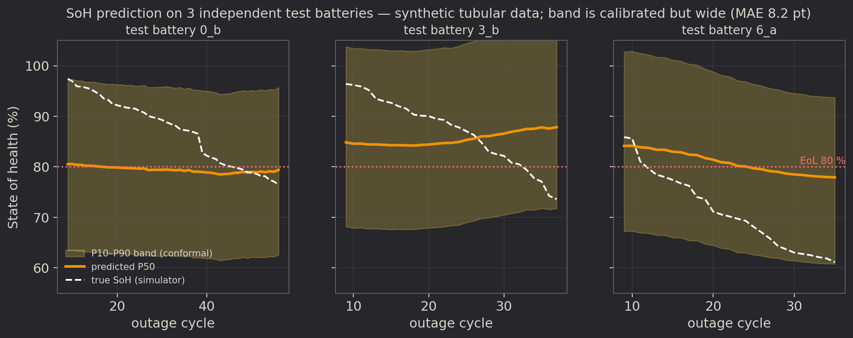
Engine 1: Predicting Battery Life
01
02
03
Estimate
Reduce
Infer
A 3-state Kalman filter (SoC, polarisation, R0) on 1 Hz current, voltage and temperature. SoC re-anchors to 100 % on charge-current taper and to the OCV table only after a true rest with the charger off.
Each outage cycle becomes 14 physics features plus 6 lifetime integrals: resistance and sag vs the battery's own baseline, throughput, depth of discharge, coulombic efficiency, charge acceptance, dQ/dV, Arrhenius heat stress.
An int8 1-D CNN over the last 30 cycles, three seeds averaged, quantile heads P10/P50/P90 with conformal calibration — a window, never a date. 16 KB of RAM, ~1–10 ms per inference on the ESP32-S3.
Measured today (synthetic tubular data, independent test split): SoH MAE 8.2 pt · 80 % band coverage 0.66 → 0.99 after calibration but still 34 pt wide · EKF within ±3 % vs 7 %/week naive drift · int8 costs +0.01 pt · target ≤ 3 pt needs the aging campaign.
V-Guard Sentinel · Team Codey Tingle (TI3271) · Big Idea Tech 2026, Track 4

Slide 6
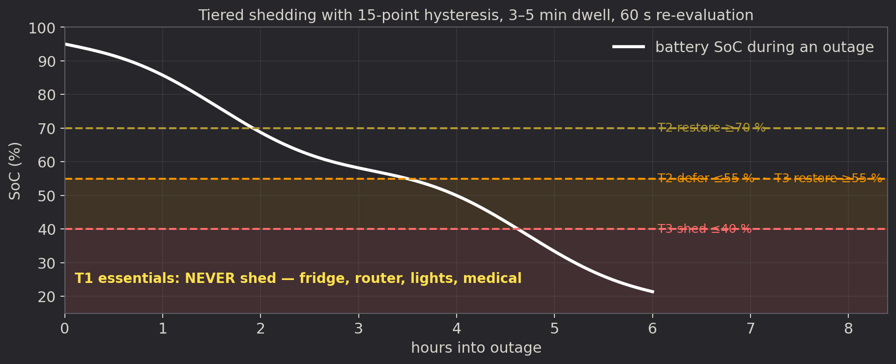
Engine 2: Autopilot That Fails Safe
How It Works
Key Benefits
• Hour-of-week load and outage tables (4.7 KB) a judge can read
• Forecasts the roster, not the storm: scheduled cuts are predictable, faults are detected
• Outage declared by a 2-of-3 vote in under 2 s; restore after 10–30 s above 0.9 pu
• T1 never shed · T2 defer ≤ 55 % · T3 shed ≤ 40 %, 15-point hysteresis, 3–5 min dwell
• Fridge, router, lights and medical loads last longest
• No chatter, no compressor short-cycling: 65 tests, 50/50 scripted scenarios in C
• 30-minute user override that cannot beat the safety floor
• Works with zero internet and no inverter cooperation
Fail-safe by wiring, not by software
Normally-closed contactors: an energised coil sheds, a de-energised coil means loads on. Any crash, brown-out or watchdog reset — and an independent supervisory timer on the driver board — drops every coil within 2 s.
V-Guard Sentinel · Team Codey Tingle (TI3271) · Big Idea Tech 2026, Track 4

Slide 7
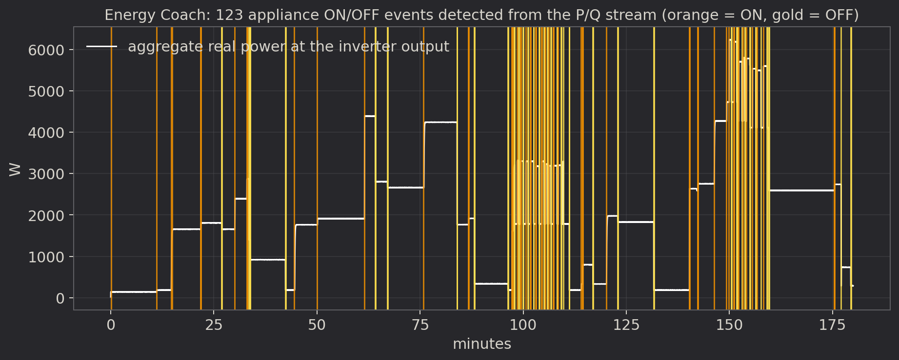
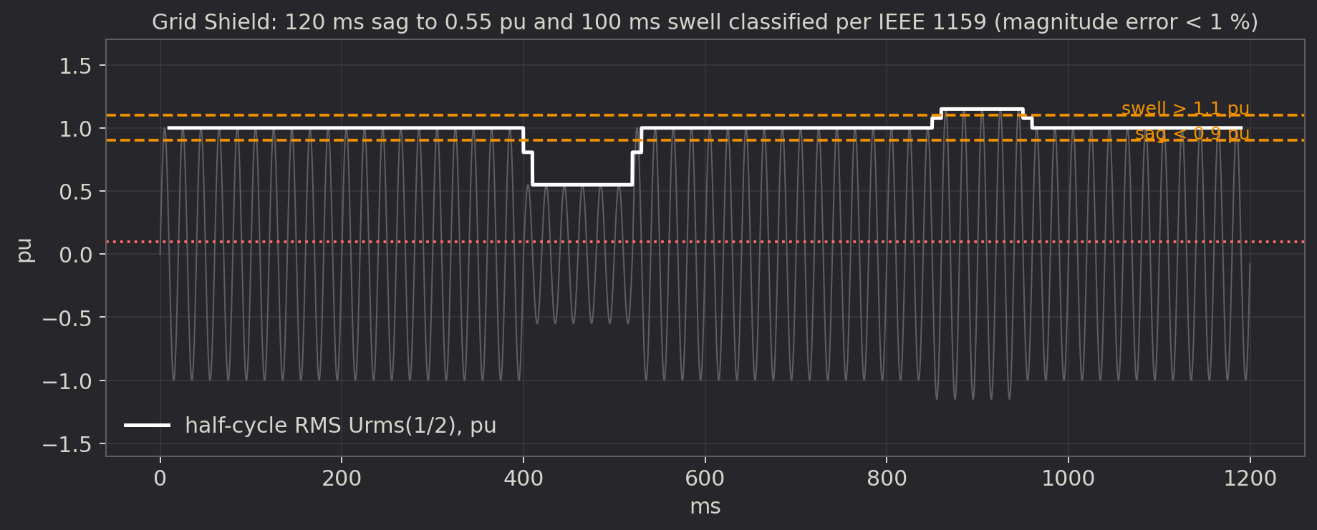
Engine 3: Energy Coach & Grid Shield
How the ESP32 tells appliances apart from one aggregate signal — and why the report's first bill of materials could not do it without a metering front-end:
1 · Detect the step
2 · Sign it
Moving-average change test on real and reactive power at 3 Hz: ΔP ≥ 25 W, settle-time limit, ON/OFF pairing.
13 numbers per event — ΔP, ΔQ, phase angle, inrush ratio, settling time, harmonic share, duration, periodicity, time of day.
3 · Match it
Grid Shield
Rules + k-NN against a per-home library seeded from an Indian appliance table and named by the user: “what just turned on?”
Half-cycle RMS on an isolated tap, IEEE 1159 buckets, 4-cycle FFT for THD. Class-S-like, never “Class A”.
Measured: event recall 1.00, fridge F1 0.97; 13/13 dips detected, magnitude error < 1 %, duration error 0 half-cycles. Honest scope: fridge, AC, geyser, pump, iron/kettle — not two identical fans, not loads under 40 W.
V-Guard Sentinel · Team Codey Tingle (TI3271) · Big Idea Tech 2026, Track 4

Slide 8
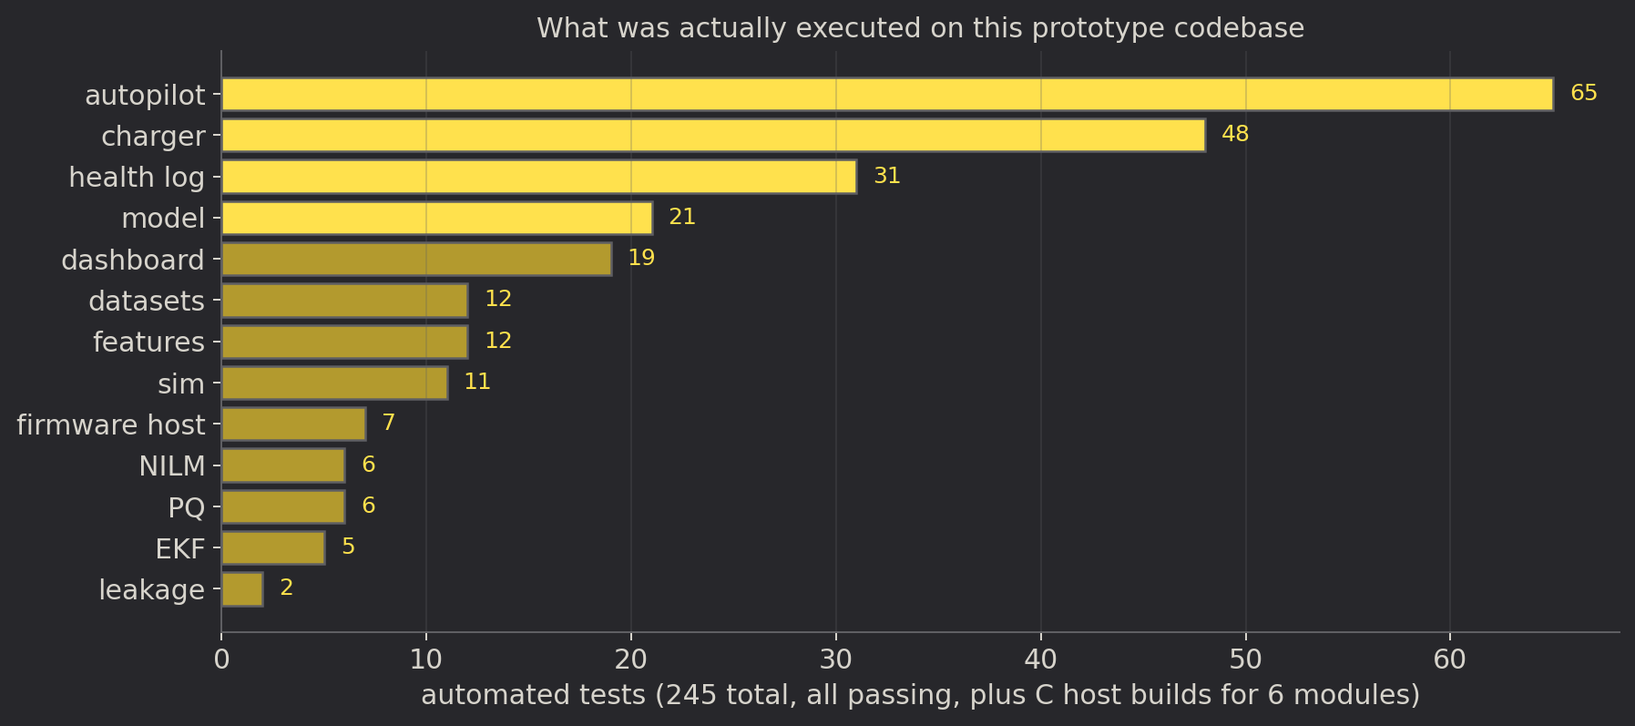
The Prototype: What Actually Runs
✓
245 automated tests · 6 C modules bit-identical to Python · full-int8 model on 3 seeds · firmware host build
Not a slide deck — a codebase. Every engine implemented, tested and reproducible with one script; the same C is linked into the ESP-IDF firmware.
Inside the repository
• Simulator + features: synthetic Indian tubular duty cycles at 1 Hz → 14 + 6 physics features per cycle
• Model pipeline: train → evaluate → int8 → .tflite, independent test split, leakage guard, transfer ablation
• EKF · autopilot · NILM · PQ · health log · charger policy: Python reference + C99 port
• Firmware: ESP-IDF task map; host binary runs the loop on a battery CSV and feeds the dashboard
• Dashboard: Flask + one page; scripted finale sequence or live device file
V-Guard Sentinel · Team Codey Tingle (TI3271) · Big Idea Tech 2026, Track 4

Slide 9
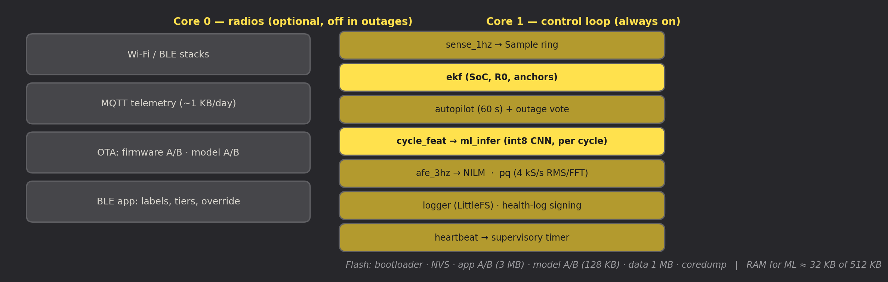
Self-Contained by Construction
Unplug the router for a year: every function below still works. The cloud only adds updates and fleet learning.
How the TinyML actually runs
• Fixed int8 weights (3 × 36.7 KB) in a signed model partition, updated independently of firmware
• TFLite Micro with six registered ops and a 16 KB arena; golden self-test at boot, fallback slot on failure
• One inference per outage cycle: the last 30 cycles in, three quantiles out
• Plain C turns quantiles into weeks and “replace within N weeks” with hysteresis
• No training on the device, ever — personalisation is ratio-to-baseline features and a conformal offset
Draw: ≈ 2.6 mA average from the battery — 0.04 % of a 150 Ah battery per day.
V-Guard Sentinel · Team Codey Tingle (TI3271) · Big Idea Tech 2026, Track 4

Slide 10
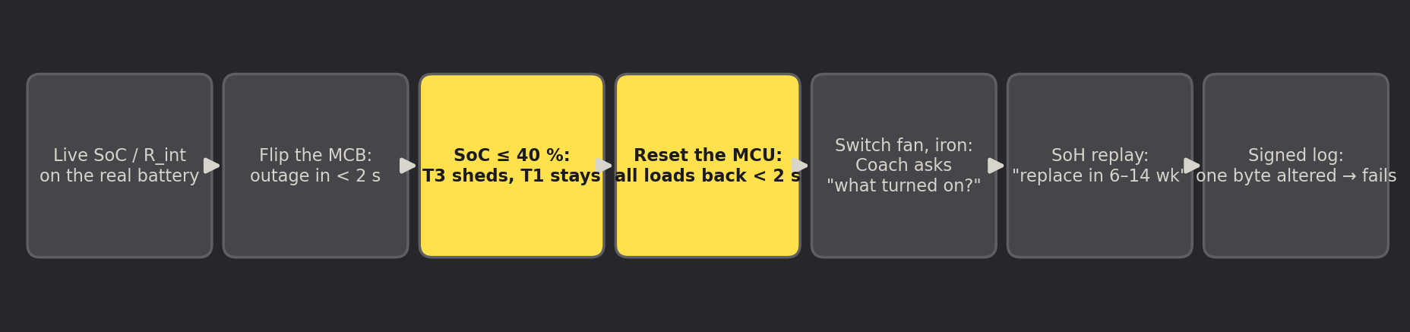
Live Demonstration
Demo Concept
Real vs replayed
“A real 12 V tubular battery and inverter on the table, three relay-switched load tiers, nothing connected to the internet — and we pull the processor's reset while the heater circuit is shed to prove that loads come back.”
• Real: SoC and R0 from the shunt and Kalman filter, outage detection, tiered shedding, fail-safe restore, appliance events, signed-log verification
• Replayed, labelled on screen: the SoH walk to “Replace within N weeks” — a bench battery does not age in a week
REPOSITORY (PRIVATE): github.com/epshukla/vguard-sentinel — design register (17 decisions), prototype code, run_all.sh reproduces every number on this deck
V-Guard Sentinel · Team Codey Tingle (TI3271) · Big Idea Tech 2026, Track 4

Slide 11
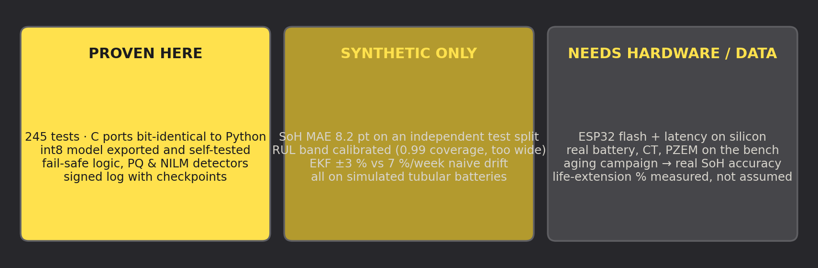
Proven · Synthetic · Still Needs Hardware
We separate what is deployable today from what is a research target — credibility is the whole game.
What building it taught us: float voltage is not open-circuit voltage; a battery shunt cannot see appliances; adaptive charging is embedded-only; federate the model that has labels on the device. Every correction is a numbered decision (D1–D17) in the design register.
V-Guard Sentinel · Team Codey Tingle (TI3271) · Big Idea Tech 2026, Track 4

Slide 12
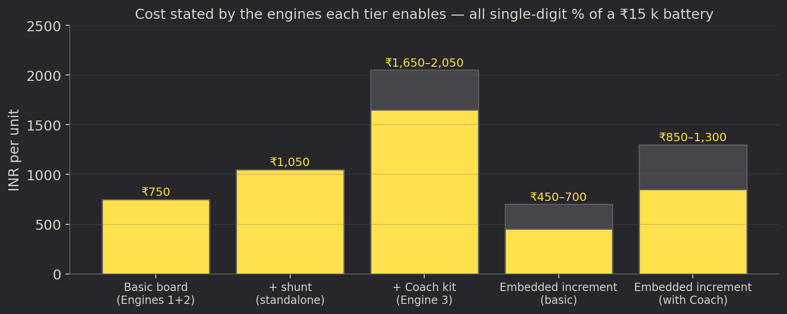
Feasibility & Growth Roadmap
Technical Feasibility
Validation Targets
• ESP32-S3 with vector extensions, ₹300
• Metering AFE class used in smart meters
• Retrofit needs no inverter modification
• Embedded slots into the Smart Pro family
• SoC within 3 % on reference shunts
• ≥ 75 % RUL-window hit-rate
• Zero unsafe sheds; fridge/AC F1 ≥ 0.8
• Life-extension % measured, not assumed
Business Value
What We Need
• Timely battery replacement revenue
• Warranty decided from signed evidence
• A premium “intelligent” tier
• A fleet-data moat no competitor can buy
• ESP32-S3 bench hardware
• One opened Prime-series inverter + charger schematic
• Batteries and cyclers for Gate 1
1
Gate 1 · Dataset (6–8 months)
24–36 tubular batteries, 3 temperatures × 3 depths × 2 regimes in the Kochi reliability lab → real SoH labels
2
Gate 2 · Field pilot (100 units, 6 months)
SoC, RUL, shedding safety, Coach accuracy and power budget verified in real homes
3
Gate 3 · Learning stability
Three model releases with no regression; embedded SKU ships in the Smart Pro family
V-Guard Sentinel · Team Codey Tingle (TI3271) · Big Idea Tech 2026, Track 4

Slide 13
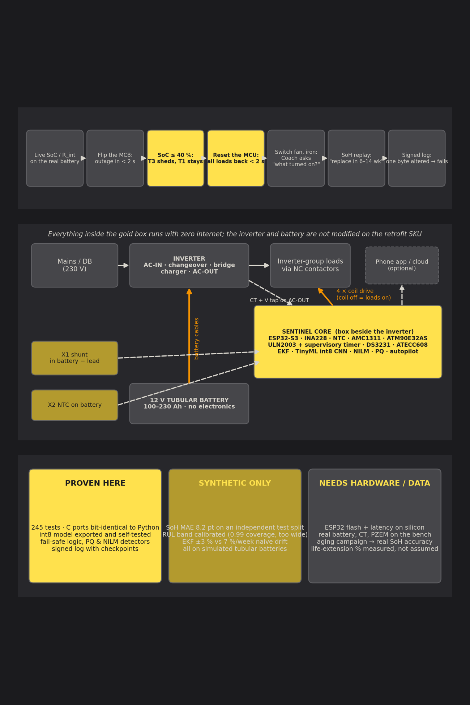
Coil off means loads on.
A window, never a date.
Offline first, fleet second.
V-Guard Sentinel — Team Codey Tingle (TI3271)
Big Idea Tech 2026 · Track 4 · Finale, Kochi, 24 September 2026
V-Guard Sentinel · Team Codey Tingle (TI3271) · Big Idea Tech 2026, Track 4

